Slide 1
ISS/ SCS/ ISE/ SCE
Release Date: DD-Mmm-YYYY

Slide 2
What is Safety Review
“Safety Evaluation” throughout development lifecycle of a drug and later on post-marketing as well. Assessment of Safety means Benefits of s drug outweigh the Risk.
The Health Authority review process involves assessing for efficacy and safety of a marketing application and consider benefit and risk.
There are several measures within a clinical submission dossier to assess adequacy of safety data, these include:
Integrated summary of safety and efficacy
Summary of clinical safety and efficacy
Risk management plan
Periodic safety reports (DSUR, PSUR, PBRER, ASR, IB, Orphan Designation Annual Report)
120 day Safety Update

Slide 3
What is Integrated Summary
The primary reason to create Integrated summary is combine various study data and to arrive at a consolidated review of the drug profile to identify the benefit/risk ratio.
The pooled data contains information of safety volunteers to study patients and helps the reviewers get a clarity of data trends and exploring the integrated data
The pooled data substantiates the observed versus expected results enabling and easing the decision making process.
The integrated data supports subgroup analysis or identifying rare data trends thus making the application robust
It is one of the requirements by FDA and other HAs to provide this summary in the NDA

Slide 4
What is Integrated Summary
ISS - Integrated Summary of Safety contains the following details:
Clinical trial data, collected form a healthy volunteers (from phase 1 study) and patients (all other studies).
Exposure of drug by the patient
Baseline / Demographic characteristics of patients enrolled in the study
Listing the deaths occurred -during the study
Drop-out patients from the study
Potential SAE, other AEs of clinical significance, toxicity grading
Lab results, Liver function test, Renal function test
ISE - Integrated Summary of Efficacy contains the following details:
Mostly clinical trial data from phase II, phase III and phase IV studies and not of phase I.
Summary of the efficacy data along with baseline / demographic characteristics impacting the efficacy results.

Slide 5
Summary of Clinical Safety and Efficacy
AS a part of the CTD in Module 2, the US FDA requires Clinical overview which comprises of Summary of clinical efficacy and safety.
The core difference between the ISE/ISS and their corresponding clinical summaries is in the depth of the analyses and the amount of information needed to support the analyses.
While documenting the larger integrated analyses of efficacy and safety in the ISE and ISS, applicants should develop a strategy and process for deriving the SCE and SCS.
The SCS (and the SCE by inference) should be a summary of the full integrated analyses of safety (and efficacy) that are routinely submitted in some regions (i.e., the ISS and ISE in the US).
The SCS and SCE should be the summary of the detailed ISS and ISE as a part of the clinical overview and should focus on the key analyses which establish the robustness and effectiveness of the drug which would be the part of the drug label

Slide 6
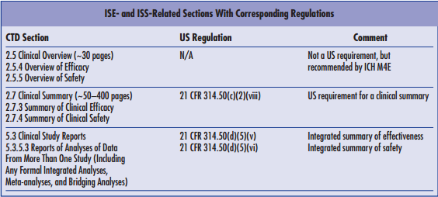
ISS/ISE versus SCS/SCE

Slide 7
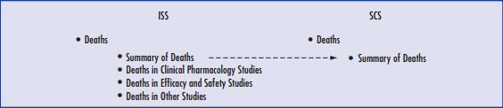
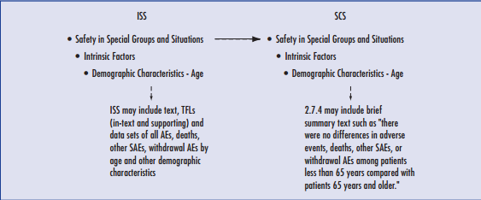
Sample transition from ISS to SCS

Slide 8
ICH pharmacovigilance documents
Risk Management Plans (RMP)
Periodic Safety Update Reports (PSUR) / Periodic Benefit Risk Evaluation Reports (PBRER)
Development Safety Update Reports (DSUR)

Slide 9
Risk Management Plan (RMP)
A Risk Management Plan (RMP) is a mechanism by which a risk management system can be presented to Competent Authorities
The format of RMPs was developed through the ICH. The RMP covers the entire life cycle of the product.
For the EU and Australia, it is mandatory for companies to submit a RMP at the time of application for a Marketing Authorisation.
RMP is also submitted if a new safety concerns are identified for a marketed product and all plans must be updated as circumstances change.
Thus companies are required to specify at the time of first marketing areas of safety about which they are currently uncertain and how they will resolve this uncertainty. They must also indicate what measures they will take to reduce known risks and how they will test whether these measures work.
Notes:
TC 1) The format of RMPs was developed through the ICH. The relevant guideline, ICH E2E was adopted in November 2004 and was implemented in the EU in late 2005.

Slide 10
Need For RMP
It is recognised that not all safety issues related to a medicine will be identified during pre-marketing trials. This can occur with new chemical entities, biological products and where a sponsor applies for use in a new population, such as in children.
A Risk Management Plan (RMP) identifies how safety concerns will be identified and mitigated
Why have RMPs been introduced?
Notes:
TC 2) The RMP covers the entire life cycle of the product. Therefore the RMP are periodically updated to reflect new knowledge and understanding of the safety profile of the product.

Slide 11
Purpose of RMP
To identify the risks associated with a medicinal product.
Develop methods to clarify further the safety profile of a product.
Plan ways to minimise risk to individual patients in clinical use.
Document measures to prevent or minimize the risks associated with the medicinal product including an assessment of the effectiveness of those interventions.
Describe what is known and not known about the safety profile of the concerned medicinal product.

Slide 12
RMP Includes
Medicine's safety profile
How its risks will be prevented or minimised in patients;
Plans for studies and other activities to gain more knowledge about the safety and efficacy of the medicine
Risk factors for developing side effects
Measuring the effectiveness of risk-minimisation measures.

Slide 13
Important terms
Identified Risk:
An untoward occurrence for which there is adequate evidence of association with the medicinal product of interest.
Examples:
An adverse reaction adequately demonstrated in non-clinical studies and confirmed by clinical data.
an adverse reaction observed in well-designed clinical trials or epidemiological studies for which the magnitude of the difference compared with the comparator group, on a parameter of interest suggests a causal relationship.
an adverse reaction suggested by a number of well-documented spontaneous reports where causality is strongly supported by temporal relationship and biological plausibility, such as anaphylactic reactions or application site reactions.

Slide 14
Important terms
Potential risk:
An untoward occurrence for which there is some basis for suspicion of an association with the medicinal product of interest but where this association has not been confirmed.
Examples :
Toxicological findings seen in non-clinical safety studies which have not been observed or resolved in clinical studies.
adverse events observed in clinical trials or epidemiological studies for which the magnitude of the difference, compared with the comparator group (placebo or active substance, or unexposed group), on a parameter of interest raises a suspicion of, but is not large enough to suggest a causal relationship;
A signal arising from a spontaneous adverse reaction reporting system;.
An event known to be associated with other active substances within the same class or which could be expected to occur based on the properties of the medicinal product.

Slide 15
When RMP Is Required?
Submission for new marketing authorisation involving
All new active ingredients
ATMPs (Advanced Therapy Medicinal Products), Gene therapy medicinal products, somatic cell therapy medicinal products and tissue engineered Products
When there is a significant change to existing license e.g. Pharmaceutical form, new indication …

Slide 16
When RMP Is Required?
When there is a changes to the production process in biotechnology Products
When seeking approval via centralized procedure for products not falling in the aforementioned categories:
Known active substance (generics) only when there are ongoing risk minimisation activities of the originator
Bibliographical applications
Fixed combination products

Slide 17
Basic Components of a Risk Management Plan
Risk Management Plan
Safety Specification
Summary of important identified risks, important potential risks and missing information
Pharmacovigilance Plan
Based on safety specification; Routine PV practices and action plan to investigate specific safety concerns
Risk Minimization
Activities to be taken to minimize the impact of specific safety concerns on the benefit-risk balance

Slide 18
Reference
http://www.fda.gov/downloads/Drugs/DevelopmentApprovalProcess/HowDrugsareDevelopedandApproved/ApprovalApplications/AbbreviatedNewDrugApplicationANDAGenerics/UCM166284.pdf
http://www.natson.com/PDF/DIAJ_36886.pdf
Overview of Risk Management Plan & Risk Minimization measures.ppt (PALS slide deck)

Slide 19

Thank You!
For any feedback/comment/clarification please contact us at PALS@tcs.com
Copyright © 2012 Tata Consultancy Services Limited
V 00.00

Slide 20
DOCUMENT RELEASE NOTICE
This XXXX, Version aa.bb, is released for use in Tata Consultancy Services (TCS) with effect from DDMMYY
This Training Material is subject to TCS Document Control Procedure. TCS reserves the right to make additions, modifications or alterations to the existing content or release a newer version of this document.
Softcopy of the latest version of the document is available in the ABCDEFG
Comments suggestions or queries should be addressed to PALS@tcs.com.
Prepared by:
Text
Role
Date:
Text
Reviewed by:
Text
Role
Date:
Text
Approved by:
Text
Role
Date:
Text
Authorized by:
Text
Role
Date:
Text
Effective Date: DD-Mmm-YYYY

Slide 21
Change/Revision History
Revision Description | Slide No. | Rationale for the Change | Change type (Add/Modify/Delete) | Modified By | Date Modified (DD-Mmm-YYYY)
Initial Release | NA | NA | NA | NA | Na

